Slide 1
Final Exam
May 6
10:15-12:00pm (Monday)
Classroom
Chapter 6 Starting Out with C++: Early Objects 5/e
slide <number>
© 2006 Pearson Education.
All Rights Reserved

Slide 2
Function
Function definition
Function type
Function call
Call by reference
Call by value
Local Variable
Global Variable
Static Variable
Chapter 6 Starting Out with C++: Early Objects 5/e
slide <number>
© 2006 Pearson Education.
All Rights Reserved

Slide 3
Array
Static memory allocation
Declaring array: int c[12];
Accessing array: c[2]=c[3]+5;
Scanning all elements in an array
Passing array as parameter in function
int f(int a[ ], int size)
Chapter 6 Starting Out with C++: Early Objects 5/e
slide <number>
© 2006 Pearson Education.
All Rights Reserved

Slide 4
Structure
Put related data together
Defining a structure
Accessing structure: example, a.name
Typedef
Pass a structure to a function
Return a structure from a function
Chapter 6 Starting Out with C++: Early Objects 5/e
slide <number>
© 2006 Pearson Education.
All Rights Reserved

Slide 5
Classes
Class definition
Private
Public
objects
Constructor
Concepts of objective oriented programming

Slide 6
Basic Expression and Types
Arithmetic expression:
+,-,*,/, %
Condition expression
==, !=, <, <=, >=, >,||, &&,!
Basic types:
int, float, double, char
Chapter 6 Starting Out with C++: Early Objects 5/e
slide <number>
© 2006 Pearson Education.
All Rights Reserved

Slide 7
Input and Output
cout
cin
Chapter 6 Starting Out with C++: Early Objects 5/e
slide <number>
© 2006 Pearson Education.
All Rights Reserved

Slide 8
Basic Statements
Assignments
a=b; a++; ++a; a--; --a;
If/else
switch
while loop
for loop
break
continue
Chapter 6 Starting Out with C++: Early Objects 5/e
slide <number>
© 2006 Pearson Education.
All Rights Reserved

Slide 9
Final Exam (1380)
10:15-12:00 pm on May 6 (Monday)
Similar to the midterm
True or False
Multiple Choice
Sample is available
Chapter 6 Starting Out with C++: Early Objects 5/e
slide <number>
© 2006 Pearson Education.
All Rights Reserved

Slide 10
Chapter 6
Functions

Slide 11
Summary of Functions
Function Definition
Function Call
Call by value (pass by value)
Call by reference (pass by reference)
Local variable
Static variable
exit()
Overloaded functions
Chapter 6 Starting Out with C++: Early Objects 5/e
slide <number>
© 2006 Pearson Education.
All Rights Reserved

Slide 12
Function Definition
Definition includes
  return type: data type of the value the function returns to the part of the program that called it
  name: name of the function. Function names follow same rules as variable names
  parameter list: variables that hold the values passed to the function
  body: statements that perform the function’s task
Chapter 6 Starting Out with C++: Early Objects 5/e
slide <number>
© 2006 Pearson Education.
All Rights Reserved

Slide 13
Function Return Type
If a function returns a value, the type of the value must be indicated
  int main()
If a function does not return a value, its return type is void
  void printHeading()
  {
  cout << "\tMonthly Sales\n";
  }
Chapter 6 Starting Out with C++: Early Objects 5/e
slide <number>
© 2006 Pearson Education.
All Rights Reserved

Slide 14
Calling a Function
To call a function, use the function name followed by () and ;
  printHeading();
When a function is called, the program executes the body of the function
After the function terminates, execution resumes in the calling function at the point of call
Chapter 6 Starting Out with C++: Early Objects 5/e
slide <number>
© 2006 Pearson Education.
All Rights Reserved
Notes:
Related, sample programs from the text are noted.
See pr6-01.cpp and pr6-02.cpp

Slide 15
6.3 Function Prototypes
Ways to notify the compiler about a function before a call to the function
  Place function definition before calling function’s definition
  Use a function prototype (similar to the heading of the function
    Heading: void printHeading()
    Prototype: void printHeading();
Chapter 6 Starting Out with C++: Early Objects 5/e
slide <number>
© 2006 Pearson Education.
All Rights Reserved
Notes:
See pr6-05.cpp

Slide 16
#include <iostream>
using namespace std;
void displayMessage(); //Prototype
int main(){
cout << "Hello from main.\n";
displayMessage(); // Call displayMessage
cout << "Back in function main again.\n";
return 0;
}
void displayMessage(){
cout << “From the function displayMessage.\n";
}
Chapter 6 Starting Out with C++: Early Objects 5/e
slide <number>
© 2006 Pearson Education.
All Rights Reserved

Slide 17
Parameters, Prototypes, and Function Headings
For each function argument,
  the prototype must include the data type of each parameter in its ()
  void evenOrOdd(int); //prototype
  the heading must include a declaration, with variable type and name, for each parameter in its ()
  void evenOrOdd(int num) //heading
The function call for the above function would look like this: evenOrOdd(val); //call
Chapter 6 Starting Out with C++: Early Objects 5/e
slide <number>
© 2006 Pearson Education.
All Rights Reserved
Notes:
See pr6-06.cpp and pr6-07.cpp

Slide 18
Calling Functions with
Multiple Arguments Illustration
displayData(height, weight); // call
void displayData(int h, int w)// heading
{
cout << "Height = " << h << endl;
cout << "Weight = " << w << endl;
}
Chapter 6 Starting Out with C++: Early Objects 5/e
slide <number>
© 2006 Pearson Education.
All Rights Reserved
Notes:
See pr6-08.cpp

Slide 19
6.5 Passing Data by Value
Pass by value: when argument is passed to a function, a copy of its value is placed in the parameter
Function cannot access the original argument
Changes to the parameter in the function do not affect the value of the argument back in the calling function
Chapter 6 Starting Out with C++: Early Objects 5/e
slide <number>
© 2006 Pearson Education.
All Rights Reserved

Slide 20
Passing Data to Parameters by Value
Example: int val = 5;
  evenOrOdd(val);
evenOrOdd can change variable num, but it will have no effect on variable val
val
num
5
5
argument in
calling function
parameter in
evenOrOdd function
Chapter 6 Starting Out with C++: Early Objects 5/e
slide <number>
© 2006 Pearson Education.
All Rights Reserved
Notes:
See pr6-09.cpp

Slide 21
6.6 The return Statement
Used to end execution of a function
Can be placed anywhere in a function
  Any statements that follow the return statement will not be executed
Can be used to prevent abnormal termination of program
Without a return statement, the function ends at its last }
Chapter 6 Starting Out with C++: Early Objects 5/e
slide <number>
© 2006 Pearson Education.
All Rights Reserved
Notes:
See pr6-10.cpp

Slide 22
#include <iostream>
using namespace std;
int square(int); //prototype
int main(){
int number, result;
cin >> number;
result = square(number);
cout << number << " squared is " << result << endl;
return 0;
}
int square(int number){return number*number; }
Chapter 6 Starting Out with C++: Early Objects 5/e
slide <number>
© 2006 Pearson Education.
All Rights Reserved

Slide 23
6.10 Local and Global Variables
local variable: defined within a function or block; accessible only within the function or block
Other functions and blocks can define variables with the same name
When a function is called, local variables in the calling function are not accessible within the called function
Chapter 6 Starting Out with C++: Early Objects 5/e
slide <number>
© 2006 Pearson Education.
All Rights Reserved
Notes:
See pr6-15.cpp

Slide 24
#include <iostream>
using namespace std;
void anotherFunction();
int main(){
int num = 1; // Local variable
cout << "In main, num is " << num << endl;
anotherFunction();
cout << "Back in main, num is still " << num << endl;
return 0;
}
void anotherFunction(){
int num = 20; // Local variable
cout << "In anotherFunction, num is " << num << endl;
}
Chapter 6 Starting Out with C++: Early Objects 5/e
slide <number>
© 2006 Pearson Education.
All Rights Reserved

Slide 25
Local and Global Variables
global variable: a variable defined outside all functions; it is accessible to all functions within its scope
Easy way to share large amounts of data between functions
Scope of a global variable is from its point of definition to the program end
Use sparingly
Chapter 6 Starting Out with C++: Early Objects 5/e
slide <number>
© 2006 Pearson Education.
All Rights Reserved
Notes:
See pr6-16.cpp

Slide 26
Initializing Local and Global Variables
Local variables must be initialized by the programmer
Global variables are initialized to 0 (numeric) or NULL (character) when the variable is defined
Chapter 6 Starting Out with C++: Early Objects 5/e
slide <number>
© 2006 Pearson Education.
All Rights Reserved
Notes:
See pr6-17.cpp

Slide 27
#include <iostream>
using namespace std;
void anotherFunction(); // Function prototype
int num = 2; // Global variable
int main(){
cout << "In main, num is " << num << endl;
anotherFunction();
cout << "Back in main, num is " << num << endl;
return 0;
}
void anotherFunction(){
cout << "In anotherFunction, num is " << num << endl;
num = 50;
cout << "But, it is now changed to " << num << endl;
}
Chapter 6 Starting Out with C++: Early Objects 5/e
slide <number>
© 2006 Pearson Education.
All Rights Reserved

Slide 28
Local and Global Variable Names
Local variables can have same names as global variables
When a function contains a local variable that has the same name as a global variable, the global variable is unavailable from within the function (local definition “hides” the global definition)
Chapter 6 Starting Out with C++: Early Objects 5/e
slide <number>
© 2006 Pearson Education.
All Rights Reserved
Notes:
See pr6-18.cpp and pr6-19.cpp

Slide 29
6.11 Static Local Variables
Local variables
  Only exist while the function is executing
  Are redefined each time function is called
  Lose their contents when function terminates
static local variables
  Are defined with key word static
  static int counter;
  Are defined and initialized only the first time the function is executed
  Retain their contents between function calls
Chapter 6 Starting Out with C++: Early Objects 5/e
slide <number>
© 2006 Pearson Education.
All Rights Reserved
Notes:
See pr6-20.cpp, pr6-21.cpp, and pr6-22.cpp

Slide 30
#include <iostream>
using namespace std;
void showLocal();
int main(){
showLocal();
showLocal();
return 0;
}
void showLocal(){
int localNum = 5; // Local variable
cout << "LocalNum is " << localNum << endl;
localNum = 99;
}
Chapter 6 Starting Out with C++: Early Objects 5/e
slide <number>
© 2006 Pearson Education.
All Rights Reserved

Slide 31
#include <iostream>
using namespace std;
void showStatic();
int main(){
for (int count = 0; count < 5; count++)
showStatic();
return 0;
}
void showStatic(){
static int statNum=5; // Static local variable
cout << "StatNum is " << statNum << endl;
statNum++;
}
Chapter 6 Starting Out with C++: Early Objects 5/e
slide <number>
© 2006 Pearson Education.
All Rights Reserved

Slide 32
Reference Variables
A reference variable is an alias for another variable
Defined with an ampersand (&)
  void getDimensions(int&, int&);
Changes to a reference variable are made to the variable it refers to
Use reference variables to implement passing parameters by reference
Chapter 6 Starting Out with C++: Early Objects 5/e
slide <number>
© 2006 Pearson Education.
All Rights Reserved

Slide 33
Pass by Reference Example
void squareIt(int &); //prototype
void squareIt(int &num)
{
num *= num;
}
int localVar = 5;
squareIt(localVar); // localVar’s
// value is now 25
Chapter 6 Starting Out with C++: Early Objects 5/e
slide <number>
© 2006 Pearson Education.
All Rights Reserved
Notes:
See pr6-24.cpp and pr6-25.cpp

Slide 34
6.15 The exit() Function
Terminates execution of a program
Can be called from any function
Can pass a value to operating system to indicate status of program execution
Usually used for abnormal termination of program
Requires cstdlib header file
Chapter 6 Starting Out with C++: Early Objects 5/e
slide <number>
© 2006 Pearson Education.
All Rights Reserved
Notes:
See pr6-30.cpp

Slide 35
Overloaded Functions Example
If a program has these overloaded functions,
  void getDimensions(int); // 1
  void getDimensions(int, int); // 2
  void getDimensions(int, float); // 3
  void getDimensions(double, double);// 4
the compiler will use them as follows:
  int length, width;
  double base, height;
  getDimensions(length); // 1
  getDimensions(length, width); // 2
  getDimensions(length, height); // 3
  getDimensions(height, base); // 4
Chapter 6 Starting Out with C++: Early Objects 5/e
slide <number>
© 2006 Pearson Education.
All Rights Reserved
Notes:
See pr6-28.cpp and pr6-29.cpp

Slide 36
Chapter 8
Arrays

Slide 37
Topics
8.1 Arrays Hold Multiple Values
8.2 Accessing Array Elements
8.3 Inputting and Displaying Array Contents
8.4 Array Initialization
8.5 Processing Array Contents
8.6 Using Parallel Arrays
8.7 The typedef Statement
Chapter 6 Starting Out with C++: Early Objects 5/e
slide <number>
© 2006 Pearson Education.
All Rights Reserved

Slide 38
Topics (continued)
8.8 Arrays as Function Arguments
8.9 Two-Dimensional Arrays
8.10 Arrays with Three or More Dimensions
8.11 Vectors
8.13 Arrays of Structures
8.14 Arrays of Class Objects
Chapter 6 Starting Out with C++: Early Objects 5/e
slide <number>
© 2006 Pearson Education.
All Rights Reserved

Slide 39
8.1 Arrays Hold Multiple Values
Array: variable that can store multiple values of the same type
Values are stored in adjacent memory locations
Declared using [] operator
  const int ISIZE = 5;
  int tests[ISIZE];
Chapter 6 Starting Out with C++: Early Objects 5/e
slide <number>
© 2006 Pearson Education.
All Rights Reserved

Slide 40
Array Storage in Memory
The definition
  int tests[ISIZE]; // SIZE is 5
allocates the following memory
first element | second element | third element | fourth element | fifth element
Chapter 6 Starting Out with C++: Early Objects 5/e
slide <number>
© 2006 Pearson Education.
All Rights Reserved

Slide 41
Array Terminology
In the definition int tests[ISIZE];
int is the data type of the array elements
tests is the name of the array
ISIZE, in [ISIZE], is the size declarator. It shows the number of elements in the array.
The size of an array is the number of bytes allocated for it
(number of elements) * (bytes needed for each element)
Chapter 6 Starting Out with C++: Early Objects 5/e
slide <number>
© 2006 Pearson Education.
All Rights Reserved

Slide 42
8.2 Accessing Array Elements
Each array element has a subscript, used to access the element.
Subscripts start at 0
subscripts
0 1 2 3 4
Chapter 6 Starting Out with C++: Early Objects 5/e
slide <number>
© 2006 Pearson Education.
All Rights Reserved

Slide 43
Accessing Array Elements
Array elements (accessed by array name and subscript) can be used as regular variables
  tests[0] = 79;
  cout << tests[0];
  cin >> tests[1];
  tests[4] = tests[0] + tests[1];
  cout << tests; // illegal due to
  // missing subscript
tests
0 1 2 3 4
Chapter 6 Starting Out with C++: Early Objects 5/e
slide <number>
© 2006 Pearson Education.
All Rights Reserved

Slide 44
Array Subscripts
Array subscript can be an integer constant, integer variable, or integer expression
Examples: Subscript is
    cin >> tests[3]; int constant
    cout << tests[i]; int variable
    cout << tests[i+j]; int expression
Chapter 6 Starting Out with C++: Early Objects 5/e
slide <number>
© 2006 Pearson Education.
All Rights Reserved

Slide 45
Inputting and Displaying
All Array Elements
To access each element of an array
  Use a loop
  Let the loop control variable be the array subscript
  A different array element will be referenced each time through the loop
for (i = 0; i < 5; i++)
  cout << tests[i] << endl;
Chapter 6 Starting Out with C++: Early Objects 5/e
slide <number>
© 2006 Pearson Education.
All Rights Reserved
Notes:
See pr8-02.cpp

Slide 46
8.4 Array Initialization
Can be initialized during program execution with assignment statements
  tests[0] = 79;
  tests[1] = 82; // etc.
Can be initialized at array definition with an initialization list
  const int ISIZE = 5;
  int tests[ISIZE] = {79,82,91,77,84};
Chapter 6 Starting Out with C++: Early Objects 5/e
slide <number>
© 2006 Pearson Education.
All Rights Reserved
Notes:
See pr8-05.cpp, pr8-06.cpp, and pr8-07.cpp

Slide 47
Partial Array Initialization
If array is initialized at definition with fewer values than the size declarator of the array, remaining elements will be set to 0 or NULL
  int tests[ISIZE] = {79, 82};
Initial values used in order; cannot skip over
elements to initialize noncontiguous range
79 | 82 | 0 | 0 | 0
Chapter 6 Starting Out with C++: Early Objects 5/e
slide <number>
© 2006 Pearson Education.
All Rights Reserved
Notes:
See pr8-08.cpp

Slide 48
Implicit Array Sizing
Can determine array size by the size of the initialization list
  short quizzes[]={12,17,15,11};
Must use either array size declarator or initialization list when array is defined
12 | 17 | 15 | 11
Chapter 6 Starting Out with C++: Early Objects 5/e
slide <number>
© 2006 Pearson Education.
All Rights Reserved

Slide 49
Sum of Array Elements
Use a simple loop to add together array elements
  float average, sum = 0;
  for (int tnum=0; tnum< ISIZE; tnum++)
  sum += tests[tnum];
Once summed, average can be computed
  average = sum/5;
Chapter 6 Starting Out with C++: Early Objects 5/e
slide <number>
© 2006 Pearson Education.
All Rights Reserved

Slide 50
Passing an Array Element
Passing a single array element to a function is no different than passing a regular variable of that data type
Function does not need to know the value it receives is coming from an array
displayValue(score[i]); // call
void displayValue(int item) // header
{ cout << item << endl;
}
Chapter 6 Starting Out with C++: Early Objects 5/e
slide <number>
© 2006 Pearson Education.
All Rights Reserved
Notes:
See pr8-14.cpp

Slide 51
8.8 Arrays as Function Arguments
To define a function that has an array parameter, use empty [] for array argument
To pass an array to a function, just use the array name
// Function prototype
  void showScores(int []);
  // Function header
  void showScores(int tests[])
  // Function call
  showScores(tests);
Chapter 6 Starting Out with C++: Early Objects 5/e
slide <number>
© 2006 Pearson Education.
All Rights Reserved

Slide 52
Passing an Entire Array
Just use array name, without any brackets, as the argument
Can also pass array size so the function knows how many elements to process
showScores(tests, 5); // call
void showScores(int[], int); // prototype
void showScores(int A[],
int size) // header
Chapter 6 Starting Out with C++: Early Objects 5/e
slide <number>
© 2006 Pearson Education.
All Rights Reserved
Notes:
See pr8-15.cpp and pr8-18.cpp

Slide 53
#include <iostream>
using namespace std;
void showValues (int nums[], int size){
for (int index = 0; index < size; index++)
cout << nums[index] << " ";
}
int main()
{
const int ARRAY_SIZE = 8;
int collection[ARRAY_SIZE]
= {5, 10, 15, 20, 25, 30, 35, 40};
showValues(collection, ARRAY_SIZE);
return 0;
}
Chapter 6 Starting Out with C++: Early Objects 5/e
slide <number>
© 2006 Pearson Education.
All Rights Reserved

Slide 54
Modifying Arrays in Functions
Array parameters in functions are similar to reference variables
Changes made to array in a function are made to the actual array in the calling function
Chapter 6 Starting Out with C++: Early Objects 5/e
slide <number>
© 2006 Pearson Education.
All Rights Reserved
Notes:
See pr8-17.cpp

Slide 55
#include <iostream>
using namespace std;
void double_array(int [ ], int);
void showValues (int [], int size);
int main(){
int set1[8] = {5, 10, 15, 20, 25, 30, 35, 40};
double_array(set1, 8);
showValues(set1, 8);
return 0;
}
Chapter 6 Starting Out with C++: Early Objects 5/e
slide <number>
© 2006 Pearson Education.
All Rights Reserved

Slide 56
void double_array(int nums[ ], int size)
{
for (int index = 0; index < size; index++)
nums[index]*=2;
}
void showValues (int nums[], int size){
for (int index = 0; index < size; index++)
cout << nums[index] << " ";
cout << endl;
}
Chapter 6 Starting Out with C++: Early Objects 5/e
slide <number>
© 2006 Pearson Education.
All Rights Reserved

Slide 57
Chapter 9
Records

Slide 58
Topics
7.1 Combining Data into Structures
7.2 Accessing Structure Members
7.3 Initializing a Structure
7.4 Nested Structures
7.5 Structures as Function Arguments
7.6 Returning a Structure from a Function
7.7 Unions
7.8 Abstract Data Types
7.9 Object-Oriented Programming
Chapter 6 Starting Out with C++: Early Objects 5/e
slide <number>
© 2006 Pearson Education.
All Rights Reserved

Slide 59
Topics (Continued)
7.10 Introduction to Classes
7.11 Introduction to Objects
7.12 Defining Member Functions
7.13 Design Considerations
7.14 Using a Constructor with a Class
7.15 Overloading Constructors
7.16 Destructors
7.17 Input Validation Objects
7.18 Using Private Member Functions
Chapter 6 Starting Out with C++: Early Objects 5/e
slide <number>
© 2006 Pearson Education.
All Rights Reserved

Slide 60
7.1 Combining Data into Structures
Structure: C++ construct that allows multiple variables to be grouped together
Structure Declaration Format:
  struct structure name
  {
  type1 field1;
  type2 field2;
  …
  typen fieldn;
  };
Chapter 6 Starting Out with C++: Early Objects 5/e
slide <number>
© 2006 Pearson Education.
All Rights Reserved

Slide 61
Example struct Declaration
  struct Student
  {
  int studentID;
  string name;
  short year;
  double gpa;
  };
structure tag
structure members
Notice the required ;
Chapter 6 Starting Out with C++: Early Objects 5/e
slide <number>
© 2006 Pearson Education.
All Rights Reserved

Slide 62
7.2 Accessing Structure Members
Use the dot (.) operator to refer to members of struct variables
  getline(cin, s1.name);
  cin >> s1.studentID;
  s1.gpa = 3.75;
Member variables can be used in any manner appropriate for their data type
Chapter 6 Starting Out with C++: Early Objects 5/e
slide <number>
© 2006 Pearson Education.
All Rights Reserved

Slide 63
Initializing a Structure (continued)
Structure members are initialized at the time a structure variable is created
Can initialize a structure variable’s members with either
  an initialization list
  a constructor
Chapter 6 Starting Out with C++: Early Objects 5/e
slide <number>
© 2006 Pearson Education.
All Rights Reserved

Slide 64
Initialization List Example
Structure Declaration Structure Variable
struct Dimensions
{ int length,
width,
height;
};
Dimensions box = {12,6,3};
box
length
12
width
6
height
3
Chapter 6 Starting Out with C++: Early Objects 5/e
slide <number>
© 2006 Pearson Education.
All Rights Reserved

Slide 65
Partial Initialization
Can initialize just some members, but cannot skip over members
Dimensions box1 = {12,6}; //OK
Dimensions box2 = {12,,3}; //illegal
Chapter 6 Starting Out with C++: Early Objects 5/e
slide <number>
© 2006 Pearson Education.
All Rights Reserved

Slide 66
7.5 Structures as Function Arguments
May pass members of struct variables to functions
  computeGPA(s1.gpa);
May pass entire struct variables to functions
  showData(s5);
Can use reference parameter if function needs to modify contents of structure variable
Chapter 6 Starting Out with C++: Early Objects 5/e
slide <number>
© 2006 Pearson Education.
All Rights Reserved

Slide 67
#include <iostream>
#include <iomanip>
#include <cmath> // Needed for the pow function
using namespace std;
struct Circle{
double radius;
double diameter;
double area;
};
void fetchInfo(Circle &round);
const double PI = 3.14159;
int main(){
Circle c1;
fetchInfo(c1);
cout<<"The Radius is "<<c1.radius<<"\n The Area is "<<c1.area;
return 0;
}
Chapter 6 Starting Out with C++: Early Objects 5/e
slide <number>
© 2006 Pearson Education.
All Rights Reserved

Slide 68
void fetchInfo(Circle &round) {
cout << "Enter the diameter of a circle: ";
cin >> round.diameter;
round.radius = round.diameter / 2;
round.area=round.radius*round.radius*PI;
}
Chapter 6 Starting Out with C++: Early Objects 5/e
slide <number>
© 2006 Pearson Education.
All Rights Reserved

Slide 69
Notes on Passing Structures
Using a value parameter for structure can slow down a program and waste space
Using a reference parameter speeds up program, but allows the function to modify data in the structure
To save space and time, while protecting structure data that should not be changed, use a const reference parameter
void showData(const Student &s)
// header
Chapter 6 Starting Out with C++: Early Objects 5/e
slide <number>
© 2006 Pearson Education.
All Rights Reserved
Notes:
See pr7-05.cpp

Slide 70
7.6 Returning a Structure from a Function
Function can return a struct
  Student getStuData(); // prototype
  s1 = getStuData(); // call
Function must define a local structure
  for internal use
  to use with return statement
Chapter 6 Starting Out with C++: Early Objects 5/e
slide <number>
© 2006 Pearson Education.
All Rights Reserved

Slide 71
Returning a Structure Example
Student getStuData()
{ Student s; // local variable
cin >> s.studentID;
cin.ignore();
getline(cin, s.pData.name);
getline(cin, s.pData.address);
getline(cin, s.pData.city);
cin >> s.year;
cin >> s.gpa;
return s;
}
Chapter 6 Starting Out with C++: Early Objects 5/e
slide <number>
© 2006 Pearson Education.
All Rights Reserved
Notes:
See pr7-06.cpp

Slide 72
Chapter 10: Classes and Data Abstraction

Slide 73
Object-Oriented Programming
Terminology
class: similar to a struct
  Allows bundling of related variables (member data) and the functions that operate on them (member functions)
  Describes the properties that all instances of the class will have
object: an instance of a class, in the same way that a variable can be an instance of a struct

Slide 74
Example
Blueprint that describes a house
(class)
Instances of house described by the blueprint
(Objects)

Slide 75
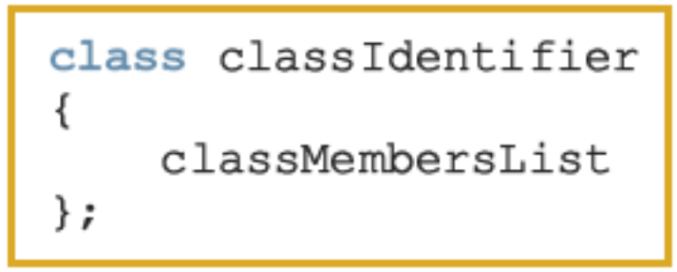
Classes
Class: collection of a fixed number of components (members)
Definition syntax:
  Defines a data type, no memory is allocated
  Don’t forget the semicolon after closing brace
C++ Programming: Program Design Including Data Structures, Fourth Edition

Slide 76
Classes (continued)
Class member can be a variable or a function
If a member of a class is a variable
  It is declared like any other variable
In the definition of the class
  You cannot initialize a variable when you declare it
If a member of a class is a function
  Function prototype is listed
  Function members can (directly) access any member of the class
C++ Programming: Program Design Including Data Structures, Fourth Edition

Slide 77
Classes (continued)
Three categories of class members
  private (default)
    Member cannot be accessed outside the class
  public
    Member is accessible outside the class
  protected
C++ Programming: Program Design Including Data Structures, Fourth Edition

Slide 78
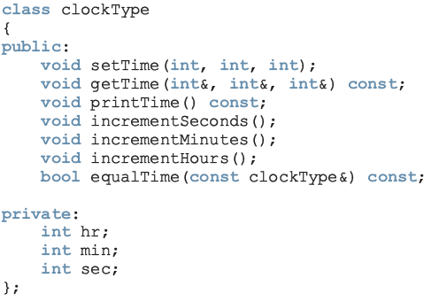
Classes (continued)
const: formal parameter can’t modify
the value of the actual parameter
These functions cannot modify the member variables of a variable of type clockType
private members,
can’t be accessed from outside the class
C++ Programming: Program Design Including Data Structures, Fourth Edition

Slide 79
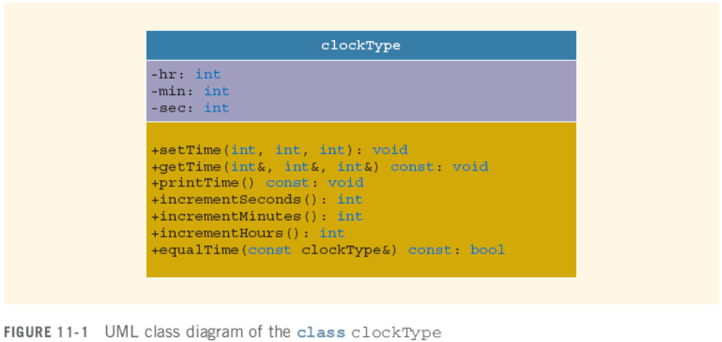
Unified Modeling Language Class Diagrams
  +: member is public
  -: member is private
  #: member is protected
C++ Programming: Program Design Including Data Structures, Fourth Edition

Slide 80
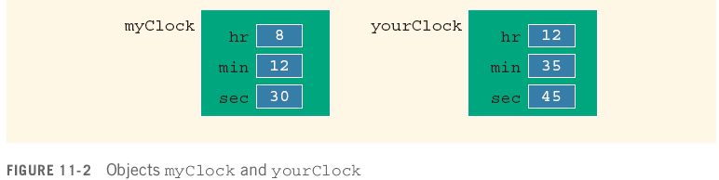
Variable (Object) Declaration
Once a class is defined, you can declare variables of that type
clockType myClock;
clockType yourClock;
A class variable is called a class object or class instance
C++ Programming: Program Design Including Data Structures, Fourth Edition

Slide 81
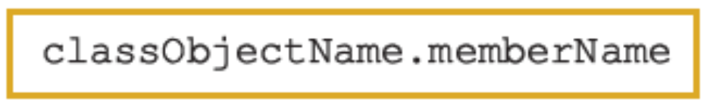
Accessing Class Members
Once an object is declared, it can access the public members of the class
Syntax:
  The dot (.) is the member access operator
If object is declared in the definition of a member function of the class, it can access the public and private members
C++ Programming: Program Design Including Data Structures, Fourth Edition

Slide 82
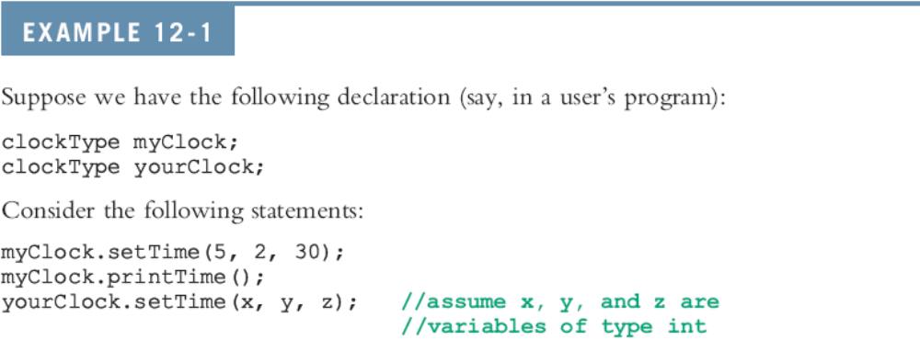
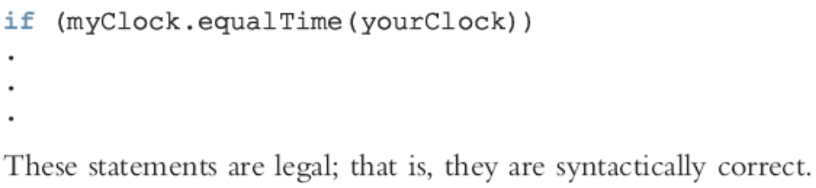
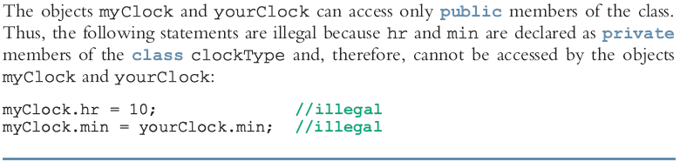

Slide 83
Built-in Operations on Classes
Most of C++’s built-in operations do not apply to classes
  Arithmetic operators cannot be used on class objects unless the operators are overloaded
  You cannot use relational operators to compare two class objects for equality
Built-in operations valid for class objects:
  Member access (.)
  Assignment (=)
C++ Programming: Program Design Including Data Structures, Fourth Edition

Slide 84
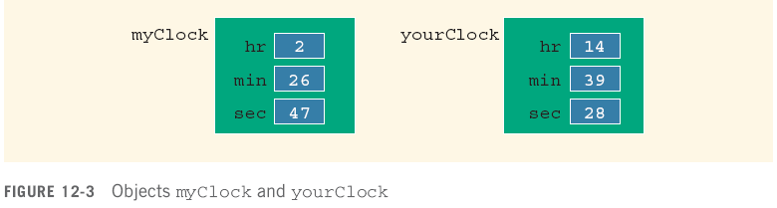
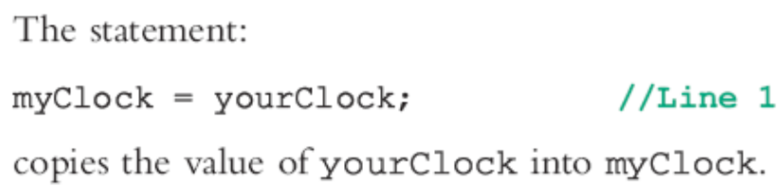
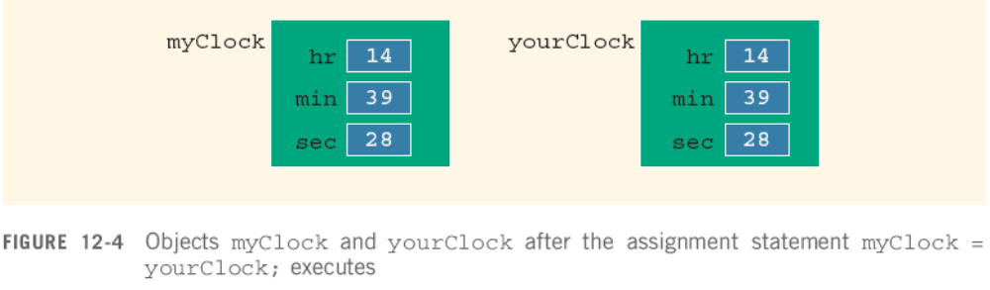

Assignment Operator and Classes
C++ Programming: Program Design Including Data Structures, Fourth Edition

Slide 85
Class Scope
An object can be automatic or static
A member of the class is local to the class
You access a class member outside the class by using the class object name and the member access operator (.)
C++ Programming: Program Design Including Data Structures, Fourth Edition

Slide 86
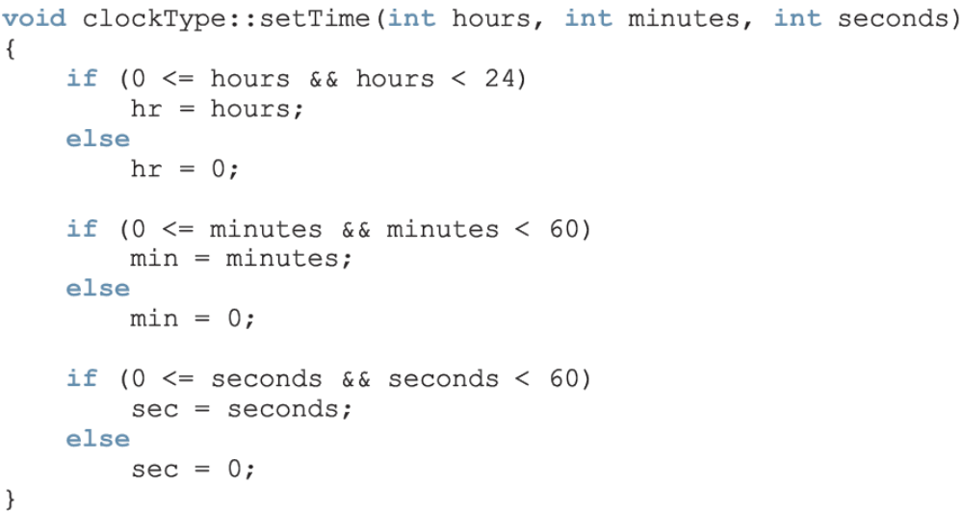
Implementation of Member Functions
Scope resolution operator
C++ Programming: Program Design Including Data Structures, Fourth Edition

Slide 87
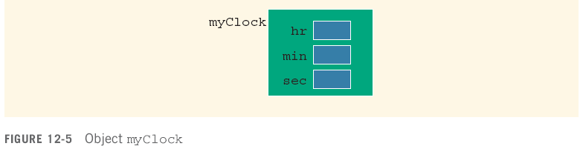


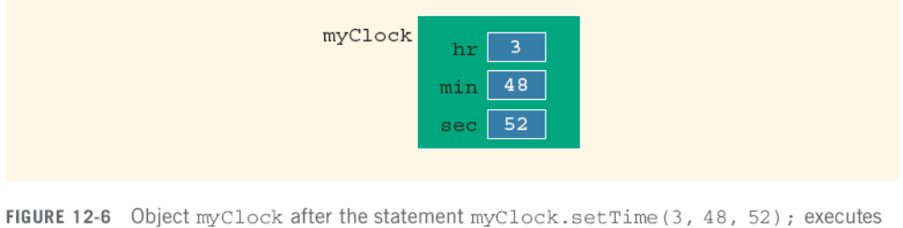
Implementation of Member Functions (continued)
C++ Programming: Program Design Including Data Structures, Fourth Edition

Slide 88
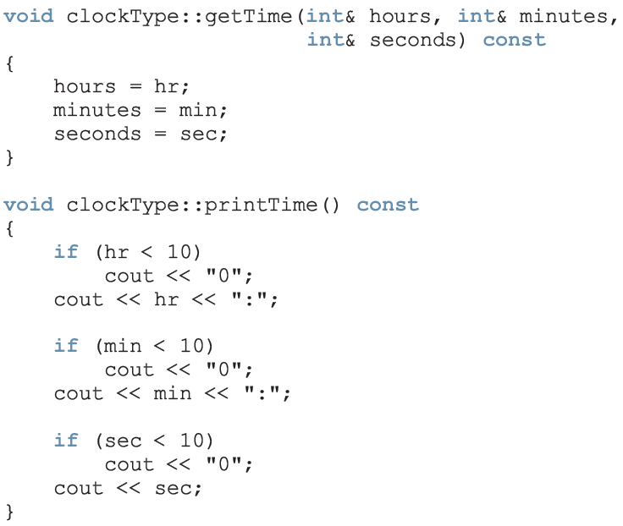

Slide 89
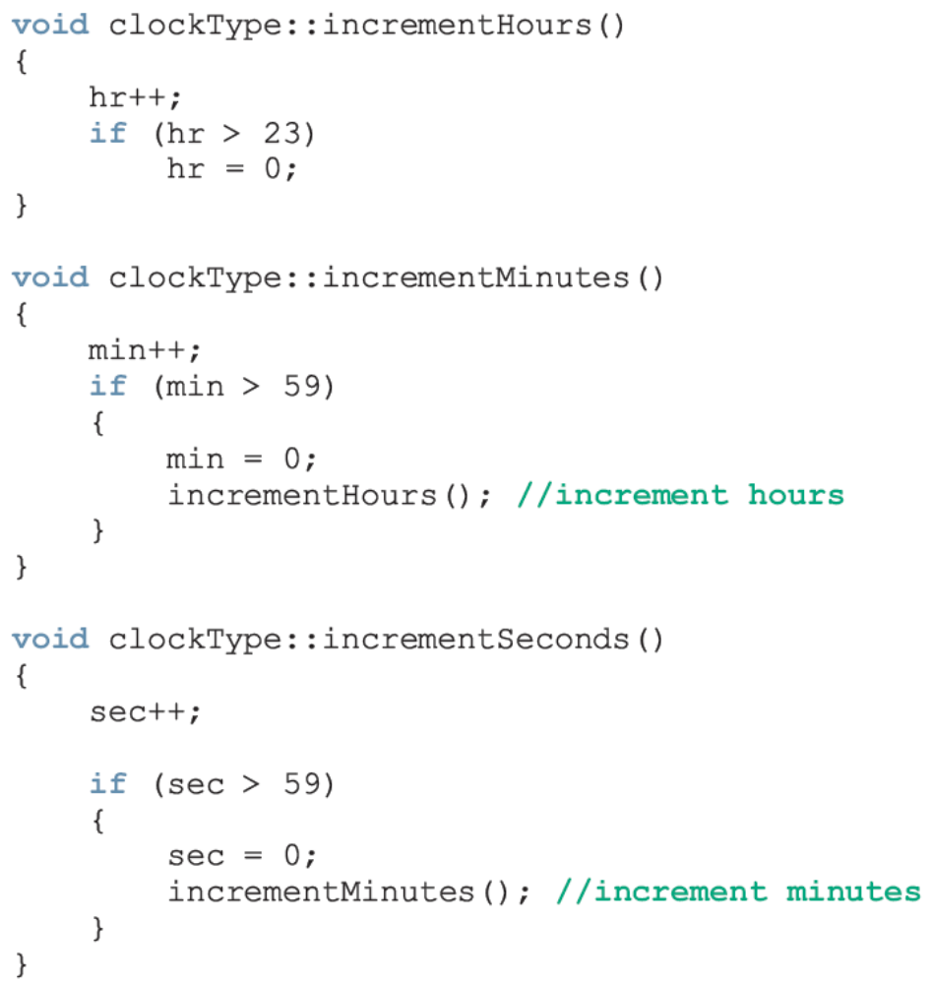

Slide 90
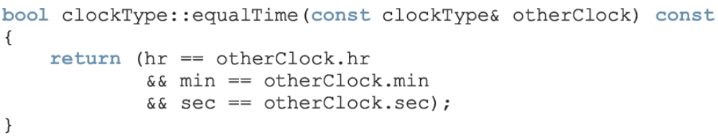
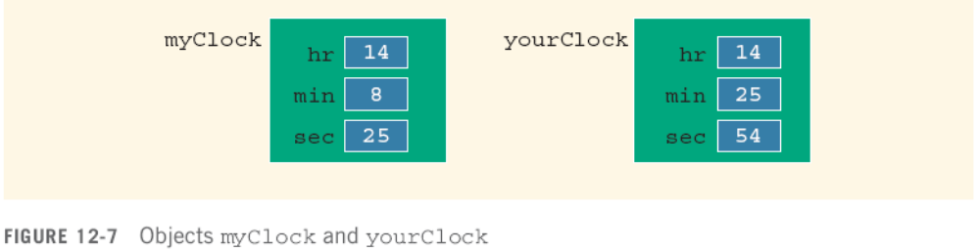

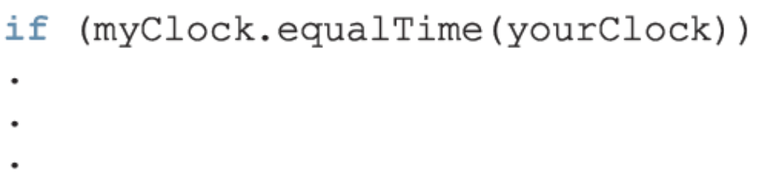
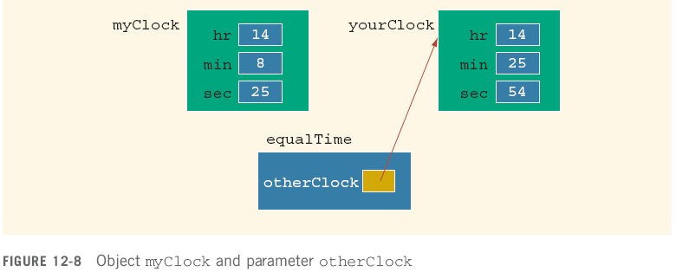


Slide 91
Constructors
Use constructors to guarantee that data members of a class are initialized
Two types of constructors:
  With parameters
  Without parameters (default constructor)
The name of a constructor is the same as the name of the class
A constructor has no type
C++ Programming: Program Design Including Data Structures, Fourth Edition

Slide 92
Constructors (continued)
A class can have more than one constructor
  Each must have a different formal parameter list
Constructors execute automatically when a class object enters its scope
  They cannot be called like other functions
  Which constructor executes depends on the types of values passed to the class object when the class object is declared
C++ Programming: Program Design Including Data Structures, Fourth Edition

Slide 93
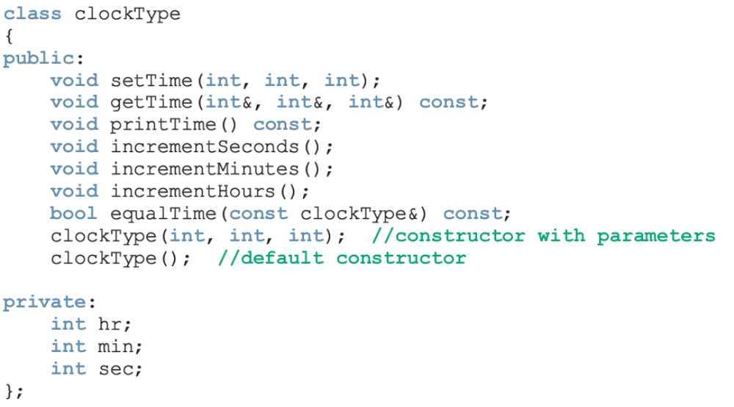
Constructors (continued)
C++ Programming: Program Design Including Data Structures, Fourth Edition

Slide 94
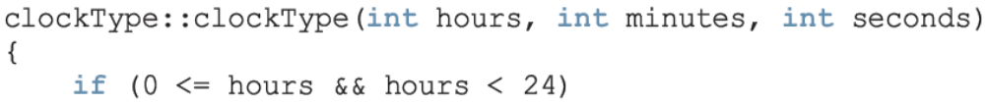
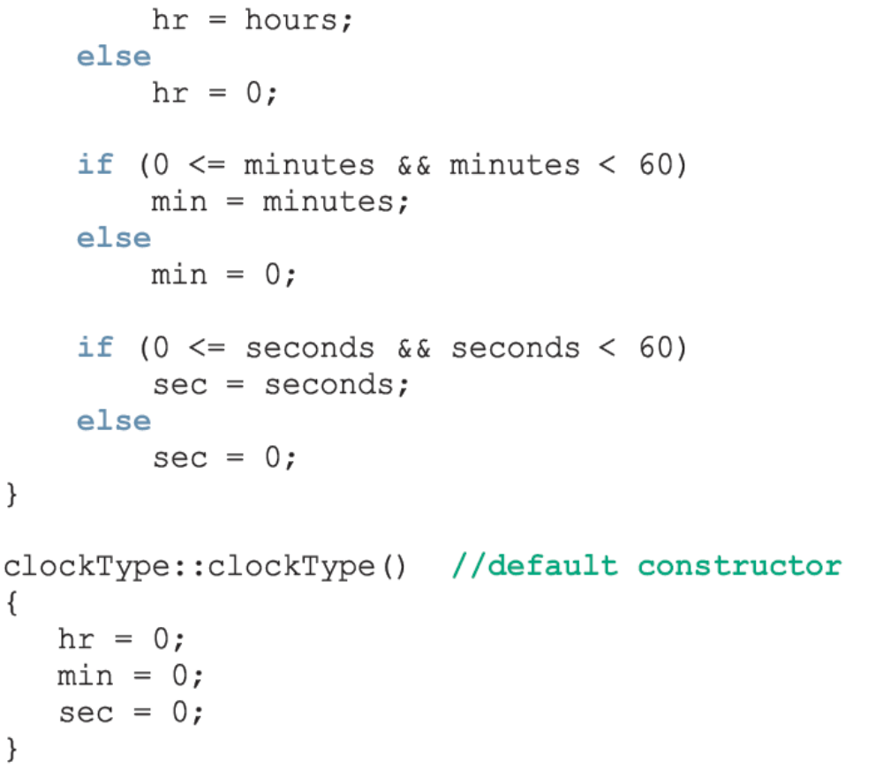
Can be replaced with:
setTime(hours, minutes, seconds);

Slide 95
Invoking a Constructor
A constructor is automatically executed when a class variable is declared
C++ Programming: Program Design Including Data Structures, Fourth Edition

Slide 96
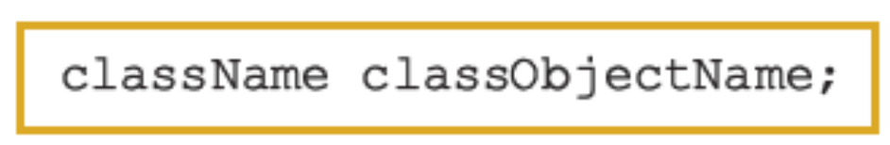
Invoking the Default Constructor
To invoke the default constructor:
Example:
clockType yourClock;
C++ Programming: Program Design Including Data Structures, Fourth Edition

Slide 97
Invoking a Constructor with Parameters
Syntax:
The number of arguments and their type should match the formal parameters (in the order given) of one of the constructors
  Otherwise, C++ uses type conversion and looks for the best match
  Any ambiguity leads to a compile-time error
C++ Programming: Program Design Including Data Structures, Fourth Edition

Slide 98
Constructors and Default Parameters
If you replace the constructors of clockType with the constructor in Line 1, you can declare clockType objects with zero, one, two, or three arguments as follows:
  clockType clock1; //Line 2
  clockType clock2(5); //Line 3
  clockType clock3(12, 30); //Line 4
  clockType clock4(7, 34, 18); //Line 5
C++ Programming: Program Design Including Data Structures, Fourth Edition

Slide 99
Classes and Constructors: A Precaution
If a class has no constructor(s), C++ provides the default constructor
  However, object declared is still uninitialized
If a class includes constructor(s) with parameter(s), but not the default constructor
  C++ does not provide the default constructor
C++ Programming: Program Design Including Data Structures, Fourth Edition

Slide 100
Destructors
Destructors are functions without any type
The name of a destructor is the character '~' followed by class name
  For example:
~clockType();
A class can have only one destructor
  The destructor has no parameters
The destructor is automatically executed when the class object goes out of scope
C++ Programming: Program Design Including Data Structures, Fourth Edition

Slide 101
#include <iostream>
#include <cmath>
using namespace std;
// Circle class declaration
class Circle
{ private:
double radius;
public:
void setRadius(double r) { radius = r; }
double getArea() { return 3.14 * pow(radius, 2); }
};
int main(){
Circle sphere1, // Define 2 Circle objects
sphere2;
sphere1.setRadius(1); // This sets sphere1's radius to 1
sphere2.setRadius(2.5); // This sets sphere2's radius to 2.5
cout << "The area of sphere1 is " << sphere1.getArea() << endl;
cout << "The area of sphere2 is " << sphere2.getArea() << endl;
return 0;
}
Chapter 6 Starting Out with C++: Early Objects 5/e
slide <number>
© 2006 Pearson Education.
All Rights Reserved

Slide 102
Data Abstract, Classes, and Abstract Data Types
Abstraction
  Separating design details from usage
  Separating the logical properties from the implementation details
Abstraction can also be applied to data
  Abstract data type (ADT): data type that separates the logical properties from the implementation details
C++ Programming: Program Design Including Data Structures, Fourth Edition

Slide 103
Chapter 18
Sorting

Slide 104
Bubble Sort Algorithm
  Compare 1st two elements and exchange them if they are out of order.
  Move down one element and compare 2nd and 3rd elements. Exchange if necessary. Continue until end of array.
  Pass through array again, repeating process and exchanging as necessary.
  Repeat until a pass is made with no exchanges.
Chapter 6 Starting Out with C++: Early Objects 5/e
slide <number>
© 2006 Pearson Education.
All Rights Reserved
Notes:
See pr9-04.cpp

Slide 105
Bubble Sort Example
Array numlist3 contains
17
23
5
11
Compare values 17 and
23. In correct order, so
no exchange.
Compare values 23 and
11. Not in correct order,
so exchange them.
Compare values 23 and
5. Not in correct order,
so exchange them.
Chapter 6 Starting Out with C++: Early Objects 5/e
slide <number>
© 2006 Pearson Education.
All Rights Reserved

Slide 106
Bubble Sort Example (continued)
After first pass, array numlist3 contains
In order from previous pass
17
5
11
23
Compare values 17 and
5. Not in correct order,
so exchange them.
Compare values 17 and
23. In correct order, so
no exchange.
Compare values 17 and
11. Not in correct order,
so exchange them.
Chapter 6 Starting Out with C++: Early Objects 5/e
slide <number>
© 2006 Pearson Education.
All Rights Reserved

Slide 107
Bubble Sort Example (continued)
After second pass, array numlist3 contains
In order from previous passes
5
11
17
23
Compare values 5 and
11. In correct order, so
no exchange.
Compare values 17 and
23. In correct order, so
no exchange.
Compare values 11 and
17. In correct order, so
no exchange.
No exchanges, so
array is in order
Chapter 6 Starting Out with C++: Early Objects 5/e
slide <number>
© 2006 Pearson Education.
All Rights Reserved

Slide 108
Chapters 1-5
Introduction, Introduction to C++, Expression, Decision, Looping,

Slide 109
Main Hardware Component Categories
Central
Processing
Unit
Input
Device
Output
Device
Main
Memory
Secondary
Storage
Devices
Chapter 6 Starting Out with C++: Early Objects 5/e
slide <number>
© 2006 Pearson Education.
All Rights Reserved

Slide 110
From a High-level Program to an Executable File
Source Code
Object Code
Preprocessor
Linker
Modified
Source Code
Executable Code
Compiler
Chapter 6 Starting Out with C++: Early Objects 5/e
slide <number>
© 2006 Pearson Education.
All Rights Reserved

Slide 111
Special Characters
Character | Name | Description
// | Double Slash | Begins a comment
# | Pound Sign | Begins preprocessor directive
< > | Open, Close Brackets | Encloses filename with #include directive
( ) | Open, Close Parentheses | Used when naming function
{ } | Open, Close Braces | Encloses a group of statements
" " | Open, Close Quote Marks | Encloses string of characters
; | Semicolon | Ends a programming statement
Chapter 6 Starting Out with C++: Early Objects 5/e
slide <number>
© 2006 Pearson Education.
All Rights Reserved
Notes:
Different, but related, sample programs from the text are noted. See pr2-01.cpp

Slide 112
2.2 The cout Object
Displays information on computer screen
Use << to send information to cout
  cout << "Hello, there!";
Can use << to send > 1 item to cout
  cout << "Hello, " << "there!";
  Or
  cout << "Hello, ";
  cout << "there!";
Chapter 6 Starting Out with C++: Early Objects 5/e
slide <number>
© 2006 Pearson Education.
All Rights Reserved
Notes:
See pr2-02.cpp and pr 2-03.cpp

Slide 113
The cin Object
User input goes from keyboard to the input buffer, where it is stored as characters
cin converts the data to the type that matches the variable
  int height;
  cout << "How tall is the room? ";
  cin >> height;
Chapter 6 Starting Out with C++: Early Objects 5/e
slide <number>
© 2006 Pearson Education.
All Rights Reserved
Notes:
Different, but related, sample programs from the text are noted.
See pr3-01.cpp and pr3-02.cpp

Slide 114
2.5 Variables and Constants
Variable
  Has a name and a type of data it can hold
  char letter;
  Is used to reference a location in memory where a value can be stored
  This value can be changed (i.e. can “vary”)
data type
variable name
Chapter 6 Starting Out with C++: Early Objects 5/e
slide <number>
© 2006 Pearson Education.
All Rights Reserved

Slide 115
Variables
  If a new value is stored in the variable, it replaces the previous value
  The previous value is overwritten and can no longer be retrieved
  int age;
  age = 17; // age is 17
  cout << age; // Displays 17
  age = 18; // Now age is 18
  cout << age; // Displays 18
Chapter 6 Starting Out with C++: Early Objects 5/e
slide <number>
© 2006 Pearson Education.
All Rights Reserved
Notes:
See pr2-07.cpp

Slide 116
Constants
Constant
  Data item whose value does not change during program execution
  Constants are also called literals
'A' // character constant
"Hello" // string constant
12 // integer constant
3.14 // floating-point constant
Chapter 6 Starting Out with C++: Early Objects 5/e
slide <number>
© 2006 Pearson Education.
All Rights Reserved
Notes:
See pr2-08.cpp

Slide 117
2.5 Assignment Statement
Uses the = operator
Has a single variable on the left side and a value on the right side
Copies the value on the right into the variable on the left
item = 12;
Chapter 6 Starting Out with C++: Early Objects 5/e
slide <number>
© 2006 Pearson Education.
All Rights Reserved

Slide 118
Defining Variables
Variables of the same type can be defined
  - In separate statements
  int length;
  int width;
  - Or in the same statement
  int length,
  width;
Variables of different types must defined in different statements
Chapter 6 Starting Out with C++: Early Objects 5/e
slide <number>
© 2006 Pearson Education.
All Rights Reserved
Notes:
See pr2-09.cpp and pr2-10.cpp

Slide 119
Integral Constants
To store an integer constant in a long memory location, put ‘L’ at the end of the number: 1234L
Constants that begin with ‘0’ (zero) are base 8: 075
Constants that begin with ‘0x’ are base 16: 0x75A
Chapter 6 Starting Out with C++: Early Objects 5/e
slide <number>
© 2006 Pearson Education.
All Rights Reserved

Slide 120
2.8 The char Data Type
Used to hold single characters or very small integer values
Usually 1 byte of memory
A numeric value representing the character is stored in memory
CODE MEMORY
char letter = 'C'; letter
67
Chapter 6 Starting Out with C++: Early Objects 5/e
slide <number>
© 2006 Pearson Education.
All Rights Reserved
Notes:
See pr2-11.cpp, pr2-12.cpp, and pr2-13.cpp

Slide 121
Assigning Floating-point Values to Integer Variables
If a floating-point value is assigned to an integer variable
  The fractional part will be truncated (i.e., “chopped off” and discarded)
  The value is not rounded
  int rainfall = 3.88;
  cout << rainfall; // Displays 3
Chapter 6 Starting Out with C++: Early Objects 5/e
slide <number>
© 2006 Pearson Education.
All Rights Reserved

Slide 122
2.11 The bool Data Type
Represents values that are true or false
bool variables are stored as short integers
false is represented by 0, true by 1
  bool allDone = true;
  bool finished = false;
allDone finished
1
0
Chapter 6 Starting Out with C++: Early Objects 5/e
slide <number>
© 2006 Pearson Education.
All Rights Reserved
Notes:
See pr2-16.cpp

Slide 123
Binary Arithmetic Operators
SYMBOL | OPERATION | EXAMPLE | ans
+ | addition | ans = 7 + 3; | 10
- | subtraction | ans = 7 - 3; | 4
* | multiplication | ans = 7 * 3; | 21
/ | division | ans = 7 / 3; | 2
% | modulus | ans = 7 % 3; | 1
Chapter 6 Starting Out with C++: Early Objects 5/e
slide <number>
© 2006 Pearson Education.
All Rights Reserved
Notes:
See pr2-20.cpp

Slide 124
Using Mathematical Expressions
Can be used in assignment statements, with cout, and in other types of statements
Examples:
  border = 2 * PI * radius;
  cout << "border is: " << (2*(l+w));
This is an expression
These are expressions
Chapter 6 Starting Out with C++: Early Objects 5/e
slide <number>
© 2006 Pearson Education.
All Rights Reserved
Notes:
See pr3-05.cpp

Slide 125
Order of Operations
In an expression with > 1 operator, evaluate in this order
  - (unary negation) in order, left to right
  * / % in order, left to right
  + - in order, left to right
In the expression 2 + 2 * 2 – 2 ,
Do first
Do next
Do last
Evaluate
2nd
Evaluate
1st
Evaluate
3rd
Chapter 6 Starting Out with C++: Early Objects 5/e
slide <number>
© 2006 Pearson Education.
All Rights Reserved

Slide 126
Associativity of Operators
- (unary negation) associates right to left
* / % + - all associate left to right
parentheses ( ) can be used to override the order of operations
  2 + 2 * 2 – 2 = 4
  (2 + 2) * 2 – 2 = 6
  2 + 2 * (2 – 2) = 2
  (2 + 2) * (2 – 2) = 0
Chapter 6 Starting Out with C++: Early Objects 5/e
slide <number>
© 2006 Pearson Education.
All Rights Reserved

Slide 127
3.3 Implicit Type Conversion
Operations are performed between operands of the same type
If not of the same type, C++ will automatically convert one to be the type of the other
This can impact the results of calculations
Chapter 6 Starting Out with C++: Early Objects 5/e
slide <number>
© 2006 Pearson Education.
All Rights Reserved

Slide 128
Hierarchy of Data Types
Highest
Lowest
Ranked by largest number they can hold
long double
double
float
unsigned long
long
unsigned int
int
Chapter 6 Starting Out with C++: Early Objects 5/e
slide <number>
© 2006 Pearson Education.
All Rights Reserved

Slide 129
Type Coercion
Coercion: automatic conversion of an operand to another data type
Promotion: converts to a higher type
Demotion: converts to a lower type
Chapter 6 Starting Out with C++: Early Objects 5/e
slide <number>
© 2006 Pearson Education.
All Rights Reserved

Slide 130
Coercion Rules
1) char, short, unsigned short are automatically promoted to int
When operating on values of different data types, the lower one is promoted to the type of the higher one.
When using the = operator, the type of
expression on right will be converted to type of variable on left
Chapter 6 Starting Out with C++: Early Objects 5/e
slide <number>
© 2006 Pearson Education.
All Rights Reserved

Slide 131
3.4 Explicit Type Conversion
Also called type casting
Used for manual data type conversion
Format
static_cast<type>(expression)
Example:
cout << static_cast<char>(65);
// Displays 'A'
Chapter 6 Starting Out with C++: Early Objects 5/e
slide <number>
© 2006 Pearson Education.
All Rights Reserved

Slide 132
3.6 Named Constants
Also called constant variables
Variables whose content cannot be changed during program execution
Used for representing constant values with descriptive names
  const double TAX_RATE = 0.0675;
  const int NUM_STATES = 50;
Often named in uppercase letters
Chapter 6 Starting Out with C++: Early Objects 5/e
slide <number>
© 2006 Pearson Education.
All Rights Reserved
Notes:
See pr3-12.cpp

Slide 133
Stream Manipulators
Used to control features of an output field
Some affect just the next value displayed
  setw(x): Print in a field at least x spaces wide. Use more spaces if specified field width is not big enough.
Chapter 6 Starting Out with C++: Early Objects 5/e
slide <number>
© 2006 Pearson Education.
All Rights Reserved

Slide 134
Stream Manipulators
Some affect values until changed again
  fixed: Use decimal notation (not E-notation) for floating-point values.
  setprecision(x):
    When used with fixed, print floating-point value using x digits after the decimal.
    Without fixed, print floating-point value using x significant digits.
  showpoint: Always print decimal for floating-point values.
  left, right: left-, right justification of value
Chapter 6 Starting Out with C++: Early Objects 5/e
slide <number>
© 2006 Pearson Education.
All Rights Reserved

Slide 135
Open the File
Open the file
Use the open member function
  inFile.open("inventory.dat");
  outFile.open("report.txt");
Filename may include drive, path info.
Output file will be created if necessary; existing output file will be erased first
Input file must exist for open to work
Chapter 6 Starting Out with C++: Early Objects 5/e
slide <number>
© 2006 Pearson Education.
All Rights Reserved

Slide 136
Use the File
Use the file
Can use output file object and << to send data to a file
  outFile << "Inventory report";
Can use input file object and >> to copy data from file to variables
  inFile >> partNum;
  inFile >> qtyInStock >> qtyOnOrder;
Chapter 6 Starting Out with C++: Early Objects 5/e
slide <number>
© 2006 Pearson Education.
All Rights Reserved
Notes:
See pr3-33.cpp. pr3-34.cpp, and pr3-35.cpp

Slide 137
Close the File
Close the file
Use the close member function
  inFile.close();
  outFile.close();
Don’t wait for operating system to close files at program end
  May be limit on number of open files
  May be buffered output data waiting to be sent to a file
Chapter 6 Starting Out with C++: Early Objects 5/e
slide <number>
© 2006 Pearson Education.
All Rights Reserved

Slide 138
4.1 Relational Operators
Used to compare numbers to determine relative order
Operators:
> | Greater than
< | Less than
>= | Greater than or equal to
<= | Less than or equal to
== | Equal to
!= | Not equal to
Chapter 6 Starting Out with C++: Early Objects 5/e
slide <number>
© 2006 Pearson Education.
All Rights Reserved

Slide 139
Relational Expressions
Relational expressions are Boolean (i.e., evaluate to true or false)
Examples:
  12 > 5 is true
  7 <= 5 is false
  if x is 10, then
  x == 10 is true,
  x != 8 is true, and
  x == 8 is false
Chapter 6 Starting Out with C++: Early Objects 5/e
slide <number>
© 2006 Pearson Education.
All Rights Reserved

Slide 140
Format of the if Statement
if (expression)
  {
  statement1;
  statement2;
  …
  statementn;
  }
The block inside the braces is called the body
of the if statement. If there is only 1 statement
in the body, the { } may be omitted.
No ; goes here
; goes here
Chapter 6 Starting Out with C++: Early Objects 5/e
slide <number>
© 2006 Pearson Education.
All Rights Reserved

Slide 141
Example if Statements
  if (score >= 60)
  cout << "You passed.\n";
  if (score >= 90)
  {
  grade = 'A';
  cout << "Wonderful job!\n";
  }
Chapter 6 Starting Out with C++: Early Objects 5/e
slide <number>
© 2006 Pearson Education.
All Rights Reserved
Notes:
See pr4-02A.cpp through pr4-02D.cpp for variations on Program 4.2 in the text.

Slide 142
if Statement Flow of Control
expression
true
false
1 or more
statements
Chapter 6 Starting Out with C++: Early Objects 5/e
slide <number>
© 2006 Pearson Education.
All Rights Reserved

Slide 143
Example if Statements
  if (score >= 60)
  cout << "You passed.\n";
  if (score >= 90)
  {
  grade = 'A';
  cout << "Wonderful job!\n";
  }
Chapter 6 Starting Out with C++: Early Objects 5/e
slide <number>
© 2006 Pearson Education.
All Rights Reserved
Notes:
See pr4-02A.cpp through pr4-02D.cpp for variations on Program 4.2 in the text.

Slide 144
4.3 The if/else Statement
Allows a choice between statements depending on whether (expression) is true or false
Format: if (expression)
  {
  statement set 1;
  }
  else
  {
  statement set 2;
  }
Chapter 6 Starting Out with C++: Early Objects 5/e
slide <number>
© 2006 Pearson Education.
All Rights Reserved

Slide 145
How the if/else Works
If (expression) is true, statement set 1 is executed and statement set 2 is skipped.
If (expression) is false, statement set 1 is skipped and statement set 2 is executed.
Chapter 6 Starting Out with C++: Early Objects 5/e
slide <number>
© 2006 Pearson Education.
All Rights Reserved

Slide 146
if/else Flow of Control
true
false
expression
statement set 1
statement
set 2
Chapter 6 Starting Out with C++: Early Objects 5/e
slide <number>
© 2006 Pearson Education.
All Rights Reserved

Slide 147
Example if/else Statements
if (score >= 60)
cout << "You passed.\n";
else
cout << "You did not pass.\n";
if (intRate > 0)
{ interest = loanAmt * intRate;
cout << interest;
}
else
cout << "You owe no interest.\n";
Chapter 6 Starting Out with C++: Early Objects 5/e
slide <number>
© 2006 Pearson Education.
All Rights Reserved
Notes:
See pr4-05.cpp and pr4-06.cpp

Slide 148
4.7 Logical Operators
Used to create relational expressions from other relational expressions
Operators, Meaning, and Explanation
&& | AND | New relational expression is true if both expressions are true
|| | OR | New relational expression is true if either expression is true
! | NOT | Reverses the value of an expression; true expression becomes false, and false becomes true
Chapter 6 Starting Out with C++: Early Objects 5/e
slide <number>
© 2006 Pearson Education.
All Rights Reserved

Slide 149
Logical Precedence
Highest !
&&
Lowest ||
Example:
(2 < 3) || (5 > 6) && (7 > 8)
is true because AND is done before OR
Chapter 6 Starting Out with C++: Early Objects 5/e
slide <number>
© 2006 Pearson Education.
All Rights Reserved

Slide 150
More on Precedence
Highest | arithmetic operators
 | relational operators
Lowest | logical operators
Example:
8 < 2 + 7 || 5 == 6 is true
Chapter 6 Starting Out with C++: Early Objects 5/e
slide <number>
© 2006 Pearson Education.
All Rights Reserved

Slide 151
switch Statement Format
switch (expression)
{
case exp1: statement set 1;
case exp2: statement set 2;
...
case expn: statement set n;
default: statement set n+1;
}
Chapter 6 Starting Out with C++: Early Objects 5/e
slide <number>
© 2006 Pearson Education.
All Rights Reserved

Slide 152
The break Statement
Used to stop execution in the current block
Also used to exit a switch statement
Useful to execute a single case statement without executing statements following it
Chapter 6 Starting Out with C++: Early Objects 5/e
slide <number>
© 2006 Pearson Education.
All Rights Reserved

Slide 153
Example switch Statement
switch (gender)
{
case 'f': cout << "female";
break;
case 'm': cout << "male";
break;
default : cout << "invalid gender";
}
Chapter 6 Starting Out with C++: Early Objects 5/e
slide <number>
© 2006 Pearson Education.
All Rights Reserved
Notes:
See pr4-23 .cpp, pr4-24.cpp, pr4-25 .cpp, and pr4-26.cpp

Slide 154
How the while Loop Works
  while (expression)
  { statement(s);
  }
expression is evaluated
  if it is true, the statement(s) are executed, and then expression is evaluated again
  if it is false, the loop is exited
Chapter 6 Starting Out with C++: Early Objects 5/e
slide <number>
© 2006 Pearson Education.
All Rights Reserved

Slide 155
while Loop Flow of Control
false
condition
true
statement(s)
Chapter 6 Starting Out with C++: Early Objects 5/e
slide <number>
© 2006 Pearson Education.
All Rights Reserved

Slide 156
while Loop Example
  int val = 5;
  while (val >= 0)
  { cout << val << " ";
  val--;
  }
produces output:
  5 4 3 2 1 0
Chapter 6 Starting Out with C++: Early Objects 5/e
slide <number>
© 2006 Pearson Education.
All Rights Reserved
Notes:
See pr5-03.cpp

Slide 157
5.8 The do-while and for Loops
do-while: a posttest loop (expression is evaluated after the loop executes)
Format:
  do
  { 1 or more statements;
  } while (expression);
Notice the required ;
Chapter 6 Starting Out with C++: Early Objects 5/e
slide <number>
© 2006 Pearson Education.
All Rights Reserved

Slide 158
do-while Flow of Control
statement(s)
true
condition
false
Chapter 6 Starting Out with C++: Early Objects 5/e
slide <number>
© 2006 Pearson Education.
All Rights Reserved
Notes:
See pr5-11.cpp

Slide 159
The for Loop
Pretest loop that executes zero or more times
Useful for counter-controlled loop
Format:
for( initialization; test; update )
{ 1 or more statements;
}
Required ;
No ; goes here
Chapter 6 Starting Out with C++: Early Objects 5/e
slide <number>
© 2006 Pearson Education.
All Rights Reserved

Slide 160
for Loop Example
int sum = 0, num;
for (num = 1; num <= 10; num++)
  sum += num;
cout << "Sum of numbers 1 – 10 is "
  << sum << endl;
Chapter 6 Starting Out with C++: Early Objects 5/e
slide <number>
© 2006 Pearson Education.
All Rights Reserved
Notes:
See pr5-13.cpp

Slide 161
for Loop Flow of Control
initialization code
update
code
false
test
true
statement(s)
Chapter 6 Starting Out with C++: Early Objects 5/e
slide <number>
© 2006 Pearson Education.
All Rights Reserved

Slide 162
5.11 Breaking Out of a Loop
Can use break to terminate execution of a loop
Use sparingly if at all – makes code harder to understand
When used in an inner loop, terminates that loop only and goes back to outer loop
Chapter 6 Starting Out with C++: Early Objects 5/e
slide <number>
© 2006 Pearson Education.
All Rights Reserved
Notes:
See pr5-16.cpp

Slide 163
5.12 The continue Statement
Can use continue to go to end of loop and prepare for next repetition
  while and do-while loops go to test and repeat the loop if test condition is true
  for loop goes to update step, then tests, and repeats loop if test condition is true
Use sparingly – like break, can make
program logic hard to follow
Chapter 6 Starting Out with C++: Early Objects 5/e
slide <number>
© 2006 Pearson Education.
All Rights Reserved
Notes:
See pr5-17.cpp

Slide 164
Prefix Mode
++val and --val increment or decrement the variable, then return the new value of the variable.
It is this returned new value of the variable that is used in any other operations within the same statement
Chapter 6 Starting Out with C++: Early Objects 5/e
slide <number>
© 2006 Pearson Education.
All Rights Reserved

Slide 165
Postfix Mode
val++ and val-- return the old value of the variable, then increment or decrement the variable
It is this returned old value of the variable that is used in any other operations within the same statement
Chapter 6 Starting Out with C++: Early Objects 5/e
slide <number>
© 2006 Pearson Education.
All Rights Reserved

Slide 166
4.10 More About Variable Definitions and Scope
Scope of a variable is the block in which it is defined, from the point of definition to the end of the block
Usually defined at beginning of function
May be defined close to first use
Chapter 6 Starting Out with C++: Early Objects 5/e
slide <number>
© 2006 Pearson Education.
All Rights Reserved
Notes:
See pr4-17A.cpp, pr4-17B.pp, and 4-17C.cpp

Slide 167
More About Variable Definitions and Scope
Variables defined inside { } have local or block scope
When in a block nested inside another block, you can define variables with the same name as in the outer block.
  When in the inner block, the outer definition is not available
  Not a good idea
Chapter 6 Starting Out with C++: Early Objects 5/e
slide <number>
© 2006 Pearson Education.
All Rights Reserved
Notes:
See pr4-18.cpp and pr4-19.cpp

Slide 168
True/False
____ 2. A value parameter only changes its own content without changing the value of the actual parameter.
Chapter 6 Starting Out with C++: Early Objects 5/e
slide <number>
© 2006 Pearson Education.
All Rights Reserved
Notes:
See pr4-18.cpp and pr4-19.cpp

Slide 169
Answer
True

Slide 170
6.5 Passing Data by Value
Pass by value: when argument is passed to a function, a copy of its value is placed in the parameter
Function cannot access the original argument
Changes to the parameter in the function do not affect the value of the argument back in the calling function
Chapter 6 Starting Out with C++: Early Objects 5/e
slide <number>
© 2006 Pearson Education.
All Rights Reserved

Slide 171
Passing Data to Parameters by Value
Example: int val = 5;
  evenOrOdd(val);
evenOrOdd can change variable num, but it will have no effect on variable val
val
num
5
5
argument in
calling function
parameter in
evenOrOdd function
Chapter 6 Starting Out with C++: Early Objects 5/e
slide <number>
© 2006 Pearson Education.
All Rights Reserved
Notes:
See pr6-09.cpp

Slide 172
True/False
____ 3. The corresponding actual parameter for a reference parameter can be any expression.
Chapter 6 Starting Out with C++: Early Objects 5/e
slide <number>
© 2006 Pearson Education.
All Rights Reserved
Notes:
See pr4-18.cpp and pr4-19.cpp

Slide 173
Answer
False

Slide 174
Reference Variables
A reference variable is an alias for another variable
Defined with an ampersand (&)
  void getDimensions(int&, int&);
Changes to a reference variable are made to the variable it refers to
Use reference variables to implement passing parameters by reference
Chapter 6 Starting Out with C++: Early Objects 5/e
slide <number>
© 2006 Pearson Education.
All Rights Reserved

Slide 175
Pass by Reference Example
void squareIt(int &); //prototype
void squareIt(int &num)
{
num *= num;
}
int localVar = 5;
squareIt(localVar); // localVar’s
// value is now 25
Chapter 6 Starting Out with C++: Early Objects 5/e
slide <number>
© 2006 Pearson Education.
All Rights Reserved
Notes:
See pr6-24.cpp and pr6-25.cpp

Slide 176
True/False
____ 7. A variable declared outside of every block is called a global variable.
Chapter 6 Starting Out with C++: Early Objects 5/e
slide <number>
© 2006 Pearson Education.
All Rights Reserved
Notes:
See pr4-18.cpp and pr4-19.cpp

Slide 177
Answer
True

Slide 178
6.10 Local and Global Variables
local variable: defined within a function or block; accessible only within the function or block
Other functions and blocks can define variables with the same name
When a function is called, local variables in the calling function are not accessible within the called function
Chapter 6 Starting Out with C++: Early Objects 5/e
slide <number>
© 2006 Pearson Education.
All Rights Reserved
Notes:
See pr6-15.cpp

Slide 179
Local and Global Variables
global variable: a variable defined outside all functions; it is accessible to all functions within its scope
Easy way to share large amounts of data between functions
Scope of a global variable is from its point of definition to the program end
Use sparingly
Chapter 6 Starting Out with C++: Early Objects 5/e
slide <number>
© 2006 Pearson Education.
All Rights Reserved
Notes:
See pr6-16.cpp

Slide 180
Initializing Local and Global Variables
Local variables must be initialized by the programmer
Global variables are initialized to 0 (numeric) or NULL (character) when the variable is defined
Chapter 6 Starting Out with C++: Early Objects 5/e
slide <number>
© 2006 Pearson Education.
All Rights Reserved
Notes:
See pr6-17.cpp

Slide 181
#include <iostream>
using namespace std;
void anotherFunction(); // Function prototype
int num = 2; // Global variable
int main(){
cout << "In main, num is " << num << endl;
anotherFunction();
cout << "Back in main, num is " << num << endl;
return 0;
}
void anotherFunction(){
cout << "In anotherFunction, num is " << num << endl;
num = 50;
cout << "But, it is now changed to " << num << endl;
}
Chapter 6 Starting Out with C++: Early Objects 5/e
slide <number>
© 2006 Pearson Education.
All Rights Reserved

Slide 182
True/False
____ 8. Using global variables in a program is a better style than using local variables because extra variables can be avoided.
Chapter 6 Starting Out with C++: Early Objects 5/e
slide <number>
© 2006 Pearson Education.
All Rights Reserved
Notes:
See pr4-18.cpp and pr4-19.cpp

Slide 183
Answer
False

Slide 184
True/False
____ 9. The scope of a formal parameter and the scope of a local variable declared in the outer block of a function body is the same.
Chapter 6 Starting Out with C++: Early Objects 5/e
slide <number>
© 2006 Pearson Education.
All Rights Reserved
Notes:
See pr4-18.cpp and pr4-19.cpp

Slide 185
Answer
True

Slide 186
True/False
____ 16. The statement int list[25]; declares list to be an array of 26 components, since the array index starts at 0.
Chapter 6 Starting Out with C++: Early Objects 5/e
slide <number>
© 2006 Pearson Education.
All Rights Reserved
Notes:
See pr4-18.cpp and pr4-19.cpp

Slide 187
Answer
False

Slide 188
Array Storage in Memory
The definition
  int tests[ISIZE]; // SIZE is 5
allocates the following memory
first element | second element | third element | fourth element | fifth element
Chapter 6 Starting Out with C++: Early Objects 5/e
slide <number>
© 2006 Pearson Education.
All Rights Reserved

Slide 189
Array Terminology
In the definition int tests[ISIZE];
int is the data type of the array elements
tests is the name of the array
ISIZE, in [ISIZE], is the size declarator. It shows the number of elements in the array.
The size of an array is the number of bytes allocated for it
(number of elements) * (bytes needed for each element)
Chapter 6 Starting Out with C++: Early Objects 5/e
slide <number>
© 2006 Pearson Education.
All Rights Reserved

Slide 190
8.2 Accessing Array Elements
Each array element has a subscript, used to access the element.
Subscripts start at 0
subscripts
0 1 2 3 4
Chapter 6 Starting Out with C++: Early Objects 5/e
slide <number>
© 2006 Pearson Education.
All Rights Reserved

Slide 191
True/False
____ 18. Arrays can be passed as parameters to a function by value, but it is faster to pass them by reference.
Chapter 6 Starting Out with C++: Early Objects 5/e
slide <number>
© 2006 Pearson Education.
All Rights Reserved
Notes:
See pr4-18.cpp and pr4-19.cpp

Slide 192
Answer
False

Slide 193
Passing an Entire Array
Just use array name, without any brackets, as the argument
Can also pass array size so the function knows how many elements to process
showScores(tests, 5); // call
void showScores(int[], int); // prototype
void showScores(int A[],
int size) // header
Chapter 6 Starting Out with C++: Early Objects 5/e
slide <number>
© 2006 Pearson Education.
All Rights Reserved
Notes:
See pr8-15.cpp and pr8-18.cpp

Slide 194
#include <iostream>
using namespace std;
void showValues (int nums[], int size){
for (int index = 0; index < size; index++)
cout << nums[index] << " ";
}
int main()
{
const int ARRAY_SIZE = 8;
int collection[ARRAY_SIZE]
= {5, 10, 15, 20, 25, 30, 35, 40};
showValues(collection, ARRAY_SIZE);
return 0;
}
Chapter 6 Starting Out with C++: Early Objects 5/e
slide <number>
© 2006 Pearson Education.
All Rights Reserved

Slide 195
Modifying Arrays in Functions
Array parameters in functions are similar to reference variables
Changes made to array in a function are made to the actual array in the calling function
Chapter 6 Starting Out with C++: Early Objects 5/e
slide <number>
© 2006 Pearson Education.
All Rights Reserved
Notes:
See pr8-17.cpp

Slide 196
True/False
____ 19. In C++, when declaring an array as a formal parameter, the size of the array must be specified within square brackets.
Chapter 6 Starting Out with C++: Early Objects 5/e
slide <number>
© 2006 Pearson Education.
All Rights Reserved
Notes:
See pr4-18.cpp and pr4-19.cpp

Slide 197
Answer
False

Slide 198
Implicit Array Sizing
Can determine array size by the size of the initialization list
  short quizzes[]={12,17,15,11};
Must use either array size declarator or initialization list when array is defined
12 | 17 | 15 | 11
Chapter 6 Starting Out with C++: Early Objects 5/e
slide <number>
© 2006 Pearson Education.
All Rights Reserved

Slide 199
True/False
____ 20. The word const is used before the array declaration in a function heading to prevent the function from modifying the array.
Chapter 6 Starting Out with C++: Early Objects 5/e
slide <number>
© 2006 Pearson Education.
All Rights Reserved
Notes:
See pr4-18.cpp and pr4-19.cpp

Slide 200
Answer
True

Slide 201
True/False
____ 24. When a two-dimensional array is passed as a parameter, the number of columns in the formal parameter must be the same as the number of columns in the actual parameter.
Chapter 6 Starting Out with C++: Early Objects 5/e
slide <number>
© 2006 Pearson Education.
All Rights Reserved
Notes:
See pr4-18.cpp and pr4-19.cpp

Slide 202
Answer
True

Slide 203
Passing a Two-Dimensional Array to a Function
Use array name as argument in function call
  getExams(exams, 2);
Use empty [] for row and a size declarator for col in the prototype and header
// Prototype, where NUM_COLS is 2
void getExams(int[][NUM_COLS], int);
// Header
void getExams
(int exams[][NUM_COLS], int rows)
Chapter 6 Starting Out with C++: Early Objects 5/e
slide <number>
© 2006 Pearson Education.
All Rights Reserved
Notes:
See pr8-20.cpp

Slide 204
True/False
____ 30. After one iteration of ascending bubble sort, the smallest element in the list is in the first position.
Chapter 6 Starting Out with C++: Early Objects 5/e
slide <number>
© 2006 Pearson Education.
All Rights Reserved
Notes:
See pr4-18.cpp and pr4-19.cpp

Slide 205
Answer
False

Slide 206
True/False
____ 31. A struct is a homogeneous data structure with all components of the same type.
Chapter 6 Starting Out with C++: Early Objects 5/e
slide <number>
© 2006 Pearson Education.
All Rights Reserved
Notes:
See pr4-18.cpp and pr4-19.cpp

Slide 207
Answer
False

Slide 208
True/False
____ 32. The members of a struct variable can be accessed in any order.
.
Chapter 6 Starting Out with C++: Early Objects 5/e
slide <number>
© 2006 Pearson Education.
All Rights Reserved
Notes:
See pr4-18.cpp and pr4-19.cpp

Slide 209
Answer
True

Slide 210
True/False
____ 35. A struct can be passed as a parameter to a function by value or by reference.
Chapter 6 Starting Out with C++: Early Objects 5/e
slide <number>
© 2006 Pearson Education.
All Rights Reserved
Notes:
See pr4-18.cpp and pr4-19.cpp

Slide 211
Answer
True

Slide 212
True/False
____ 36. A member of a struct can be another struct.
Chapter 6 Starting Out with C++: Early Objects 5/e
slide <number>
© 2006 Pearson Education.
All Rights Reserved
Notes:
See pr4-18.cpp and pr4-19.cpp

Slide 213
Answer
True

Slide 214
True/False
____ 37. Memory is allocated when you define a struct.
Chapter 6 Starting Out with C++: Early Objects 5/e
slide <number>
© 2006 Pearson Education.
All Rights Reserved
Notes:
See pr4-18.cpp and pr4-19.cpp

Slide 215
Answer
False

Slide 216
True/False
____ 39. The contents of a struct variable must be written one member at a time.
Chapter 6 Starting Out with C++: Early Objects 5/e
slide <number>
© 2006 Pearson Education.
All Rights Reserved
Notes:
See pr4-18.cpp and pr4-19.cpp

Slide 217
Answer
True

Slide 218
True/False
____ 40. A function can return a value of the type struct.
Chapter 6 Starting Out with C++: Early Objects 5/e
slide <number>
© 2006 Pearson Education.
All Rights Reserved
Notes:
See pr4-18.cpp and pr4-19.cpp

Slide 219
Multiple Choice
____ 41. If an & is attached after the data type of a formal parameter, then the formal parameter is a _____.
A)value parameter
B)reference parameter
C)global variable
D)default variable
Chapter 6 Starting Out with C++: Early Objects 5/e
slide <number>
© 2006 Pearson Education.
All Rights Reserved
Notes:
See pr4-18.cpp and pr4-19.cpp

Slide 220
Answer
B

Slide 221
Multiple Choice
X=10; Y=15; mystery(x,y);
void mystery(int & one, int two)
{ int temp; temp=one; one=two; two=temp;}
____ 42. What are the values of x and y after the statements above execute? (Assume that variables are properly declared.)
A)x = 10; y = 10 C)x = 15; y = 10
B)x = 10; y = 15 D)x = 15; y = 15
Chapter 6 Starting Out with C++: Early Objects 5/e
slide <number>
© 2006 Pearson Education.
All Rights Reserved
Notes:
See pr4-18.cpp and pr4-19.cpp

Slide 222
Answer
D

Slide 223
Multiple Choice
void funtcBeta(int &one, double two) { …. }
____46. Based on the function definition above, which of the following statements is valid?
A)one is a value parameter and two is a reference parameter.
B)one is a reference parameter and two is a value parameter.
C)one and two are reference parameters.
D)one and two are value parameters.
Chapter 6 Starting Out with C++: Early Objects 5/e
slide <number>
© 2006 Pearson Education.
All Rights Reserved
Notes:
See pr4-18.cpp and pr4-19.cpp

Slide 224
Answer
B

Slide 225
Multiple Choice
49. _____ identifiers are not accessible outside of the function (block).
A)Local C) Internal
B) Global D) External
Chapter 6 Starting Out with C++: Early Objects 5/e
slide <number>
© 2006 Pearson Education.
All Rights Reserved
Notes:
See pr4-18.cpp and pr4-19.cpp

Slide 226
Answer
A

Slide 227
Multiple Choice
____ 50. Memory for _____ variables remains allocated as long as the program executes.
A) actual C) global
B) formal D) local
Chapter 6 Starting Out with C++: Early Objects 5/e
slide <number>
© 2006 Pearson Education.
All Rights Reserved
Notes:
See pr4-18.cpp and pr4-19.cpp

Slide 228
Answer
C

Slide 229
Multiple Choice
____ 56. Assume you have the following declaration char nameList[100];. Which of the following ranges is valid for the index of the array nameList?
A) 0 through 99 C) 1 through 100
B) 0 through 100 D) 1 through 101
Chapter 6 Starting Out with C++: Early Objects 5/e
slide <number>
© 2006 Pearson Education.
All Rights Reserved
Notes:
See pr4-18.cpp and pr4-19.cpp

Slide 230
Answer
A

Slide 231
Multiple Choice
Int list[10]; int j;
____ 57. Consider the declaration above. Which of the following codes correctly outputs all the elements of list?
A) for (j=1; j<10; j++) cout<<list[j]<<“ “;
B) for (j=0; j<=9; j++) cout<<list[j]<<“ “;
C) for (j=1; j<11; j++) cout<<list[j]<<“ “;
D) for (j=1; j<=10; j++) cout<<list[j]<<“ “;
Chapter 6 Starting Out with C++: Early Objects 5/e
slide <number>
© 2006 Pearson Education.
All Rights Reserved
Notes:
See pr4-18.cpp and pr4-19.cpp

Slide 232
Answer
B

Slide 233
Multiple Choice
____ 58. Consider the following declaration int alpha[3];. Which of the following input statements correctly inputs values into alpha?
A)cin>>alpha>>alpha>>alpha;
B)cin>>alpha[0]>>alpha[1]>>alpha[2];
C)cin>>alpha[1]>>alpha[2]>>alpha[3];
D)cin>>alpha
Chapter 6 Starting Out with C++: Early Objects 5/e
slide <number>
© 2006 Pearson Education.
All Rights Reserved
Notes:
See pr4-18.cpp and pr4-19.cpp

Slide 234
Answer
B

Slide 235
Multiple Choice
int list[5]={0, 5, 10, 15, 20}; int j;
for (j=1; j<=5; j++) cout<<list[ j ] <<“ “; cout<endl;
____ 59. What is the output of the C++ code above?
A) 0 5 10 15 20 C) 5 10 15 20 20
B) 5 10 15 20 0 D) Code contains index out-of-bounds
Chapter 6 Starting Out with C++: Early Objects 5/e
slide <number>
© 2006 Pearson Education.
All Rights Reserved
Notes:
See pr4-18.cpp and pr4-19.cpp

Slide 236
Answer
D

Slide 237
Multiple Choice
___ 63. Given the function prototype void mystery(int list[], int size); and the declaration int alpha[50];, which of the following is a valid call to the function mystery?
A) mystery(alpha[50]); C) mystery(alpha,50);
B) mystery(alpha[],50); D) mystery(alpha{50});
Chapter 6 Starting Out with C++: Early Objects 5/e
slide <number>
© 2006 Pearson Education.
All Rights Reserved
Notes:
See pr4-18.cpp and pr4-19.cpp

Slide 238
Answer
C

Slide 239
Multiple Choice
____ 64. Consider the following statement: double alpha[10][5];. The number of components of alpha is _____.
A) 15 C) 100
B) 50 D) 150
Chapter 6 Starting Out with C++: Early Objects 5/e
slide <number>
© 2006 Pearson Education.
All Rights Reserved
Notes:
See pr4-18.cpp and pr4-19.cpp

Slide 240
Answer
B

Slide 241
Multiple Choice 60
struct studentType1{
string name; int ID; double gpa;
};
studentType1 student1, student2;
struct studentType2{
string name; int ID; double gpa;
};
studentType2 student3, student4;
Chapter 6 Starting Out with C++: Early Objects 5/e
slide <number>
© 2006 Pearson Education.
All Rights Reserved
Notes:
See pr4-18.cpp and pr4-19.cpp

Slide 242
Multiple Choice
____ 74. Consider the statements above. Which of the following statements is valid in C++?
A) student2 = student3;
B) student1 = student4;
C) student2.ID = ID;
D) student1.ID = student3.ID;
Chapter 6 Starting Out with C++: Early Objects 5/e
slide <number>
© 2006 Pearson Education.
All Rights Reserved
Notes:
See pr4-18.cpp and pr4-19.cpp

Slide 243
Answer
D

Slide 244
Multiple Choice 74
struct supplierType{
string name;
int supplierID;
};
struct paintType{
supplierType supplier;
string color;
string paintID;
};
paintType paint;
Chapter 6 Starting Out with C++: Early Objects 5/e
slide <number>
© 2006 Pearson Education.
All Rights Reserved
Notes:
See pr4-18.cpp and pr4-19.cpp

Slide 245
Multiple Choice
____ 75. Consider the statements above. What is the data type of paint.supplier?
A) string
B) paintType
C) supplierType
D) struct
Chapter 6 Starting Out with C++: Early Objects 5/e
slide <number>
© 2006 Pearson Education.
All Rights Reserved
Notes:
See pr4-18.cpp and pr4-19.cpp

Slide 246
Answer
C

